Slide 1
Soar 9.6.0

Slide 2
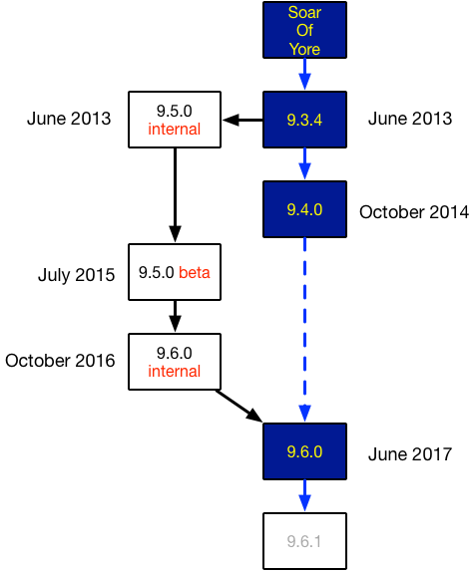
History
9.6.0 is 1st non-beta release in over 2.5 years
Many new features and fixes
9.6.0 is 1st official release based on a research branch that had many low-level changes
Forked from the 9.3 branch in 2013
Developed in parallel with 9.4 branch
1st version with all 3 platforms in 1 download
No 32-bit binary downloads
32-bit support will still be maintained/tested but users will need to build from source.

Slide 3
Overview
Three key new capabilities
Explanation-based rule learning
Instance-based semantic memory
Spreading semantic memory activation (beta)
User interface improvements
Streamlined commands
Summary and settings screens
New commands and options
Improved agent inspection
Rule explanations
Visualization of learning and memory systems
Agent-controlled debug output and changes to execution trace settings
Improved robustness
Nuggets and Coals

Slide 4
Three Key New Capabilities
Quick Overview. Each of these systems has a presentation of its own.

Slide 5
Explanation-Based Rule Learning
Explanation-based chunking (EBC) is a powerful, new learning mechanism that allows your agent to learn rules on the fly based on the its problem-solving and/or interactions it has with its environment.
Key Points:
Learns far more general and expressive rules
Significantly improves Soar’s ability to learn knowledge that will transfer to future situations
Easy to use
Agent design should not require significant changes to support this learning
Many options to fine-tune learning for your domain or agent design

Slide 6
Explanation-Based Rule Learning
Explanation-based chunking (EBC) is a powerful, new learning mechanism that allows your agent to learn rules on the fly based on the its problem-solving and/or interactions it has with its environment.
Key Points:
Final version of algorithm. Much more robust and stable.
4 years of R&D, 3rd version of underlying algorithm
Core identity analysis algorithm is entirely new and does not have efficiency issues that other EBL algorithms we tried had.
Most aspects have been completely re-written since 9.5.0 beta
Far more efficient when learning is off than previous versions of EBC
Currently used by nearly every one of our research projects

Slide 7
Instance-Based Semantic Memory
Soar 9.6.0 implements a new model of memory system interaction in which each memory system has its own completely independent identifiers. No more LTIs in working memory.
Why?
New representation is more flexible and can handle situations hybrid LTIs had difficulty with. Some examples:
Representing the different versions of a semantic memory over time
Building and reasoning about hypotheticals involving semantic memory
Dealing with multiple word meanings
Eliminates many issues where one semantic memory recall created unexpected interactions with a previous memory system recall
Eliminates mixed hybrid nature of LTIs
Was considered a constant in some situations and an identifier in others, which caused many problems in the code base

Slide 8
Instance-Based Semantic Memory
Key Points:
Every recall now creates a new instance of a memory, which means no long-term identifiers ever exist in the other 3 memory systems
Soar now maintains invisible links between semantic memory and linked identifiers in different memory systems
Soar rule syntax now has new condition tests that you can use in your rules to take advantage of these links
Agents now also have new commands that they can use to properly retrieve/store/update semantic memory structures based on those links
Implementation was painful, but conversion of agents was not
9.4.0 semantic memory databases may need to be converted

Slide 9
Spreading Activation of Semantic Memory (beta)
When you have structures in working memory that were either retrieved or stored in semantic memory, spreading activation boosts the activation of other, connected semantic memory structures.
Key Points:
Potential to do cool associative memory stuff
Steven and Jules’ talks will show examples of this
Well-tested but still experimental. Considered a beta version.
Does have a performance hit (has not been optimized)
When enabled, semantic memory usage is significantly slower
When disabled, semantic memory usage is slightly slower than 9.4.0
For agents that don't use semantic memory at all, there is no cost.
Disabled by default

Slide 10
User Interface and Presentation Improvements

Slide 11
Motivation
Commands have continually grown over the years:
They have been added in an ad hoc fashion often using different styles of option arguments.

Slide 12
Motivation for streamlining
Soar 9.4.0’s command list is very long:
Discourages exploration of all the tools Soar provides, even among veteran Soar users.
add-wme
alias
allocate
capture-input
chunk-name-format
cli
clog
command-to-file
default-wme-depth
echo
echo-commands
edit-production
epmem
excise
explain-backtraces
firing-counts
gds-print
gp
gp-max
help
indifferent-selection
init-soar
internal-symbols
learn
load-library
matches
max-chunks
max-dc-time
max-elaborations
max-goal-depth
max-memory-usage
max-nil-output-cycles
memories
multi-attributes
numeric-indifferent-mode
o-support-mode
pbreak
port
predict
preferences
print
production-find
pwatch
rand
remove-wme
replay-input
rete-net
rl
run
save-backtraces
select
set-library-location
set-stop-phase
smem
soarnews
source
sp
srand
stats
stop-soar
svs
time
timers
unalias
verbose
version
waitsnc
warnings
watch
watch-wmes
wma

Slide 13
General Strategy (2012 Proposal)
Standardize
All commands should use same argument style
Make command/option names more consistent and intuitive (some progress)
Organize and combine
Hierarchical commands to reduce number of top-level (complete) commands and give users indication of what commands do and how they relate to each other
Ameliorate presentation
Consistent command feedback and output (some progress)
Improved help pages and categorized help menu
Quick access to commonly used information (significant progress)
Reduce
Remove obsolete commands/settings (complete)
Merge commands that simply change a setting (complete)
Reduce complexity of more “bloated” commands

Slide 14
Streamlined Commands

Slide 15
Spoiler: Result of Streamlining

Slide 16
9.4.0 Command List (tl;dr)
add-wme
alias
allocate
capture-input
chunk-name-format
cli
clog
command-to-file
default-wme-depth
echo
echo-commands
edit-production
epmem
excise
explain-backtraces
firing-counts
gds-print
gp
gp-max
help
indifferent-selection
init-soar
internal-symbols
learn
load-library
matches
max-chunks
max-dc-time
max-elaborations
max-goal-depth
max-memory-usage
max-nil-output-cycles
memories
multi-attributes
numeric-indifferent-mode
o-support-mode
pbreak
port
predict
preferences
print
production-find
pwatch
rand
remove-wme
replay-input
rete-net
rl
run
save-backtraces
select
set-library-location
set-stop-phase
smem
soarnews
source
sp
srand
stats
stop-soar
svs
time
timers
unalias
verbose
version
waitsnc
warnings
watch
watch-wmes
wma
+ file system commands

Slide 17
9.6.0 Command List
alias
chunk
debug
decide
echo
epmem
explain
gp
help
load
output
preferences
print
production
rl
run
save
smem
soar
sp
stats
svs
trace
visualize
wm
+ file system commands

Slide 18
How? EVANESCO!
Unchanged:
alias
echo
epmem
gp
help
preferences
print
rl
run
smem
sp
stats
svs
But added 2 new commands
explain
visualize
Removed 7 commands
edit-production
explain-backtraces
o-support-mode
rand
save-backtraces
set-library-location
soarnews
Merged 4 commands into existing commands
chunk-name-format
max-chunks
gds-print
unalias
Merged 45 commands into 8 new “meta-commands”
debug
decide
load
output
production
save
soar
wm
Also renamed 2 commands:
learn -> chunk
watch -> trace
-7
+8
-45
-4
+2

Slide 19
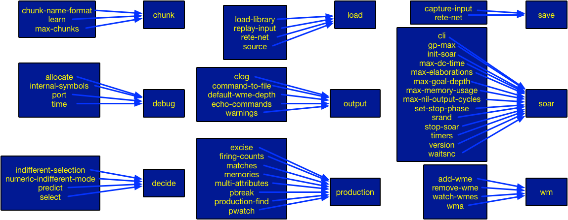
Combining Commands and Options
Note: This is just to show grouping. There are more detailed slides for most of these commands later in presentation.

Slide 20
Nuggets and Coal
Nuggets
Soar 9.6.0 has 25 core commands
99% backwards compatible
Even ‘help’ with an old command name will still work
Soar accepts partial commands and sub-commands!
“so in” is so in in Soar 9.6.0
Lumps of Coal
Command argument styles are still not consistent
Help entries are now even more cumbersome
Many choices were subjective or determined by how easy they were to quickly implement

Slide 21
Settings and Summary Screens
Many of the new commands and meta-commands now have the ability to show a quick print-out of commonly used information.

Slide 22
Getting Summary Information More Quickly
These screens are intended to reduce the need to find stats or scroll through the much longer, more verbose help entries.
Summary Screens:
Show stats related to a system
Shows current value of the system’s most important settings
Settings Screens
Show all sub-commands, options and legal values for options
Shows all settings with their current values
Each sub-command or setting has a one-line help description

Slide 23
Accessing Summary Screens
Accessed by issuing one the command to the right with no arguments
chunk
decide
explain
output
production
smem
soar

Slide 24
Getting Settings Information More Quickly
These screens are intended to reduce the need to find stats or scroll through the much longer, more verbose help entries.
Summary Screens:
Show stats related to a system
Shows current value of the system’s most important settings
Settings Screens
Show all sub-commands, options and legal values for options
Shows all settings with their current values
Each sub-command or setting has a one-line help description

Slide 25
Accessing Settings Screens
Accessed by issuing a command followed by a ‘?’:
chunk ?
debug ?
decide ?
explain ?
load ?
output ?
production ?
save ?
soar ?
smem ?
trace ?
visualize ?
wm ?

Slide 26
Which Commands Have These Screens?
Commands with summary screens:
chunk
decide
explain
output
production
smem
soar
Commands with settings screens:
chunk*
debug*
decide
explain*
load
output*
production
save
soar*
smem*
trace*
visualize*
wm
Summary Screens:
Show stats related to a system
Shows current value of the system’s most important settings
Settings Screens
Show all sub-commands, options and legal values for options
Shows all settings with their current values
Each sub-command or setting has a one-line help description
* Command has one-line help description for each sub-command or setting

Slide 27
New Commands and Options

Slide 28
“Meta-Commands”: soar, load and save

Slide 29
“Meta-Commands”: output, decide

Slide 30
“Meta-Commands”: production and wm

Slide 31
“Meta-Commands”: explain and visualize

Slide 32
New Save Commands
The new save command adds the ability to save rules directly to a file
save agent
Saves all rules
Saves content of semantic memory
Saves some commonly used settings
save chunks
Saves only newly learned rules

Slide 33
Semantic Memory Database Conversion
smem --export <filename> [lti-id]
Will export your smem database into a text file composed of a sequence of smem --adds
This file can be sourced into any new version of Soar we release
Note: We have a special version of Soar 9.4.0 that will allow you to export 9.4.0 database so that you can import them into 9.6.0. Contact me if you need more info.

Slide 34
New RL Option: GQ(λ) Off-Policy Learning
This reinforcement learning option provides off-policy learning quite effectively.
This is a good approach in cases when agent training performance is less important than agent execution performance.
GQ(λ) converges despite irreversible actions and other difficulties approaching the training goal.
Convergence should be guaranteed for stable environments.
Note: This was also available in Soar 9.5.0 beta

Slide 35
Other New Commands and Options
There are other new commands and options that have been added since 9.4.0. Please see the release notes or the manual for more information.

Slide 36
Improved Agent Inspection

Slide 37
Explain and Visualize
‘explain’
Now works with latest version of EBC
Now explains identity analysis
See 2016 Workshop talk for basic usage
‘visualize’
Now handles working memory
Now renders semantic memory natively with all of the new visualization options
Now uses colors to show identities in backtraces
See 2016 workshop talk for basic usage

Slide 38
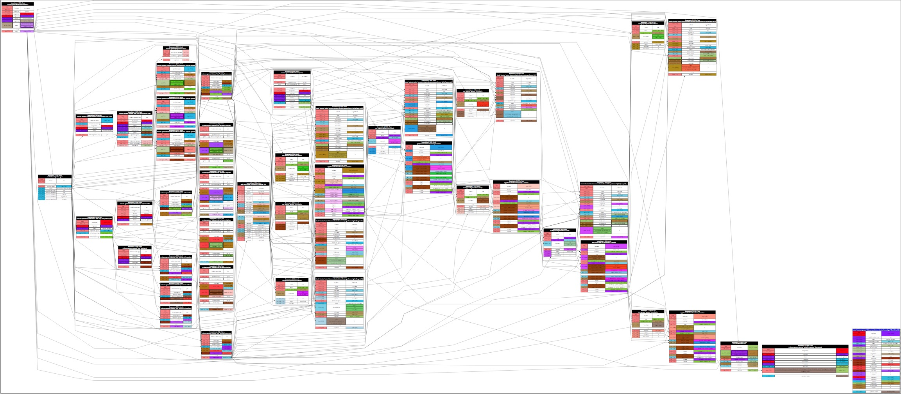
Colored Visualization of a Learned Rule

Slide 39
Agent Traces
The ‘watch’ command has had several fixes, changes and a little bit of reorganization

Slide 40
Agent Traces
There is a new ‘trace’ RHS function
Not a soar command. Just like the RHS function ‘write’ (trace 2 |Writing to channel 2!| (crlf))
Requires a number as first argument, which allows you to specify a “trace channel” for that write
Then use following command to selectively turn on/off agent trace channels
output agent-trace 2 on
New global option to turn off all agent ‘write’ and ‘trace’ commands
output agent-writes off
New global option to completely turn off output (more off than watch 0)
output enabled off
New output option to switch agent callbacks to print to std::out

Slide 41
Improved Robustness
Soar is now able to handle many problem cases which would previously causes crashes or aborting

Slide 42
Improved Robustness
We’ve now dealt with every bug report accumulated over the last decade (a few bugs are left)
Does not include bugs that were feature requests
Full list of bugs fixed can be found in the 9.6.0 release notes
Many low-level memory leaks identified and fixed

Slide 43
Improved Robustness
Soar now has over 400 unit tests in a new unit test framework
An expansion of the prototype unit testing framework developed a few years ago by Alex Turner.
Half chunking unit tests and half general ones, including many ported from jSoar
Soar now has a new updated performance testing tool
Was used to identify several sources of bad slow-downs in experimental branch
Helped identify problem that led to development of this year’s new EBC algorithm
Implemented various internal inventory mechanisms to insure proper clean-up of Soar data structures
These types of problems aren’t easily found with normal leak tools
Instantiations, preferences, WMEs, GDSs, identity sets, tests, RHS values, RHS symbols all now have an inventory mechanism

Slide 44
Improved Robustness
Areas that have been reviewed and fixed, refactored or re-written
All procedural learning code (more than once)
Semantic memory
Context consistency maintenance system (GDS)
EBC explanation system
Visualization code

Slide 45
Improved Robustness
Areas that have been reviewed and fixed, refactored or re-written
Soar high-level memory management code for creation, management and deallocation of:
Working memory
Preference memory
Instantiations
Reinforcement-learning template code
The Tcl command-line plug-in (Aaron/Mazin)
(Episodic memory code is currently being reviewed by Steven)

Slide 46
Golden Nuggets and Lumps of Coal
Nuggets
Big release with lots of stuff
May be more stable and robust than 9.4.0 in some ways
New manual in the works too!
Preeti, Bryan, Mazin, John
Coals
Needs more profiling and optimization
Needs more documentation polish
Too much stuff for a talk
Available within a couple of weeks! You can find it at:
http://soar.eecs.umich.edu/articles/downloads/soar-suite

